Slide 1

Deliverable 5
User Interface Design, Program design and System Implementation

Slide 2
Who Are We?
Muhammad Hamza - Project Manager
Siril Pattammady - Systems Developer
Josh Johnson - Systems Analyst
Khadija Shafiq - Business Analyst
Jay Patel - Network Engineer
Shaikha Al Shamsi - Requirement Analyst

Slide 3


Recap of Osiris Merger w/ Smith and Nephew
The Osiris to Smith and Nephew merger has lead to a large scale integration project for laptop deployment and network development. This involves the implementation of the Smith and Nephew information technology department to create a standalone windows image, to supply necessary resources, and to configure systems on a user to user need basis and as a company as a whole.

Slide 4
Interface design prototypes
Home Page
Laptop Request Page
Software Request Page
Contact/Service Page

Slide 5
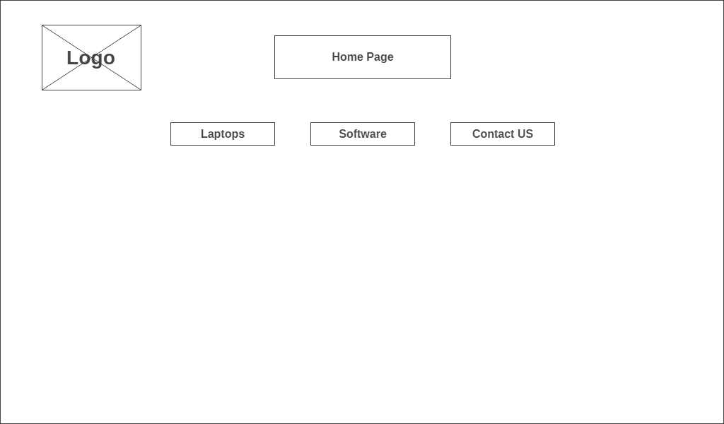
Home Page

Slide 6
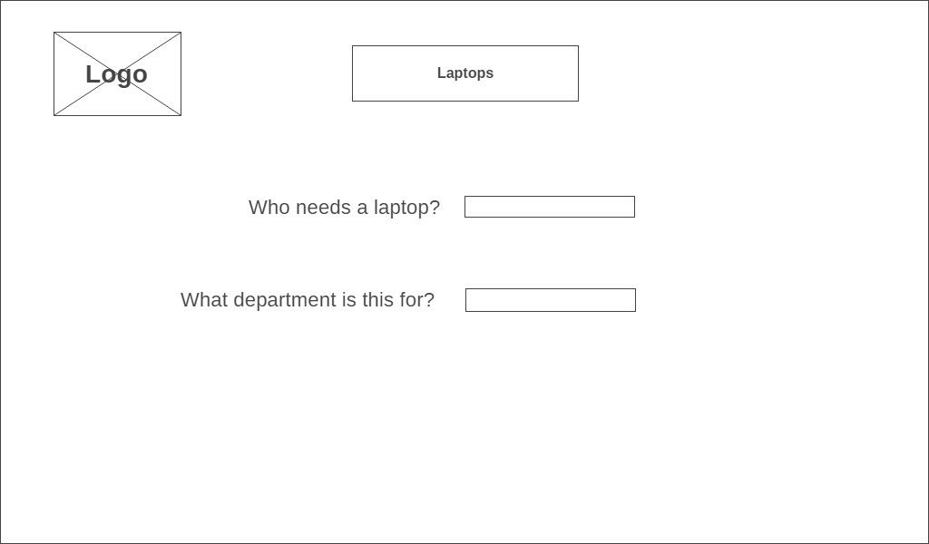
Laptop Request Page

Slide 7
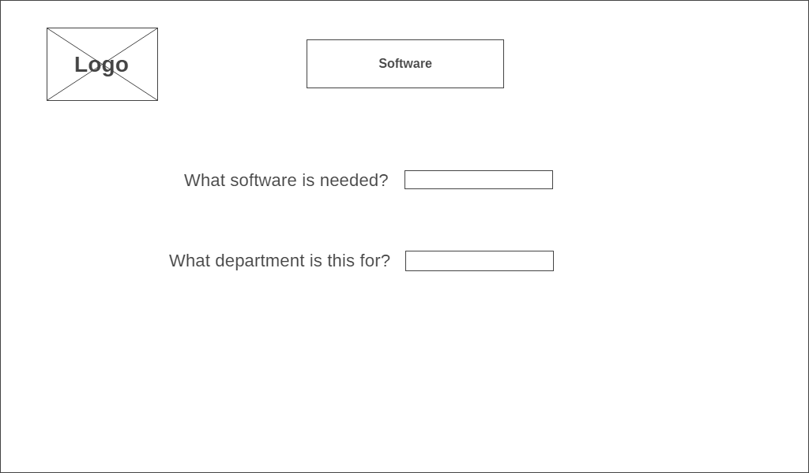
Software Request Page

Slide 8
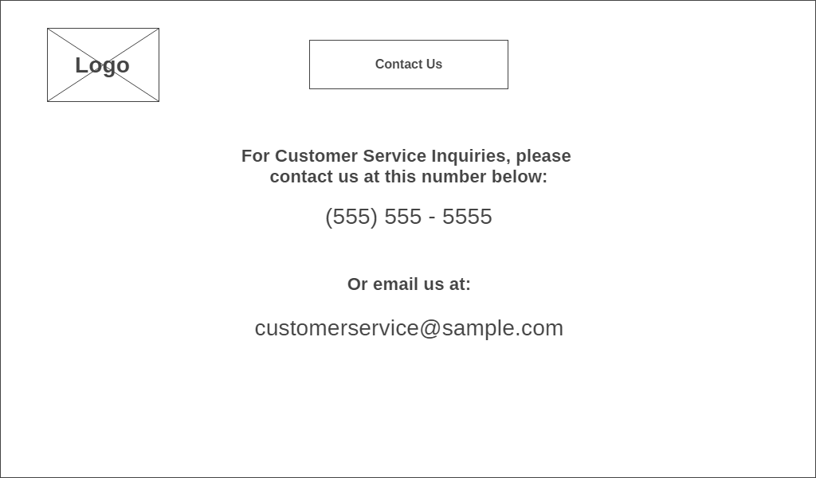
Contact/Service Page

Slide 9
Interface Standards
What are Interface Standards?
The interface standards are the basic design elements that are common across the individual screens, forms, and reports within the system.
Interface Metaphor
The metaphor will help the user to understand the system and enables the user to predict what features the interface might provide
Interface objects and Actions
The interface actions are common commands that will be employed by the users.
Interface Icons
Icons are small pictures that will appear on command buttons as well as in forms and reports to highlight important information.
Interface Templates
The interface template will defines the general appearance of all interface components in the information system (screens, forms, and reports).

Slide 10
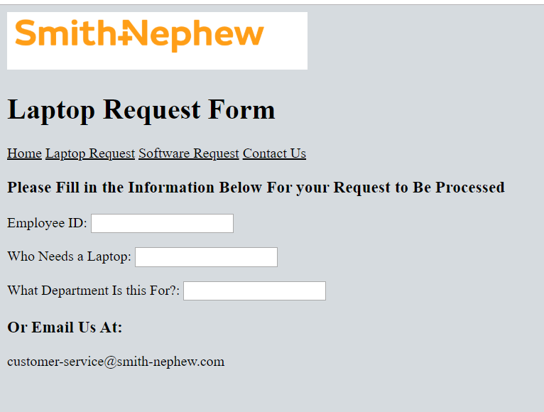
Program Design
Laptop Request
https://is436group.github.io/IS436DELIVERABLES/Deliverable%205/HomePage.html

Slide 11
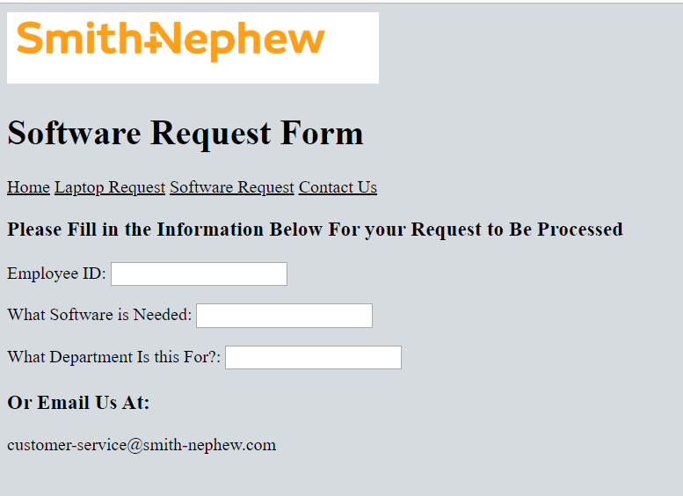
Program Design
Software Request

Slide 12
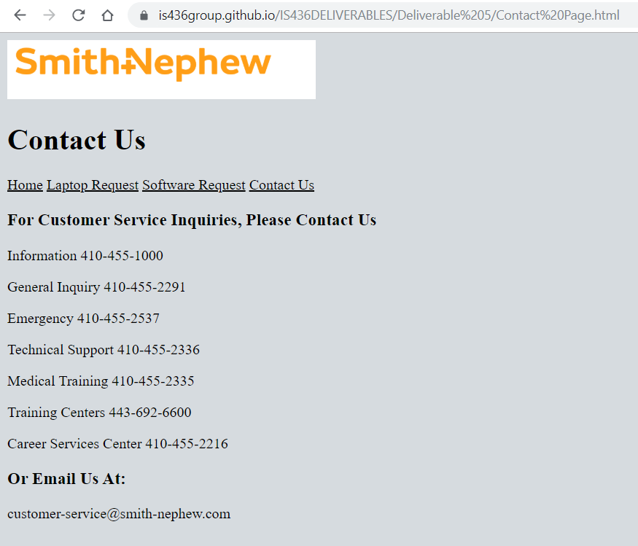
Program Design
Contact Page

Slide 13
System Requirements for Implementation
In order to implement our project, all that is needed is a web platform in order to access the HTML site. With this site in place any user with the correlating link will be able to send a request or be able to contact. A higher level requirement to be implemented will be once the merger database is created between Smith and Nephew and Osiris, then all the requests can be stored into the database platform for all the requests to be noted and completed in a frame amount of time.

Slide 14
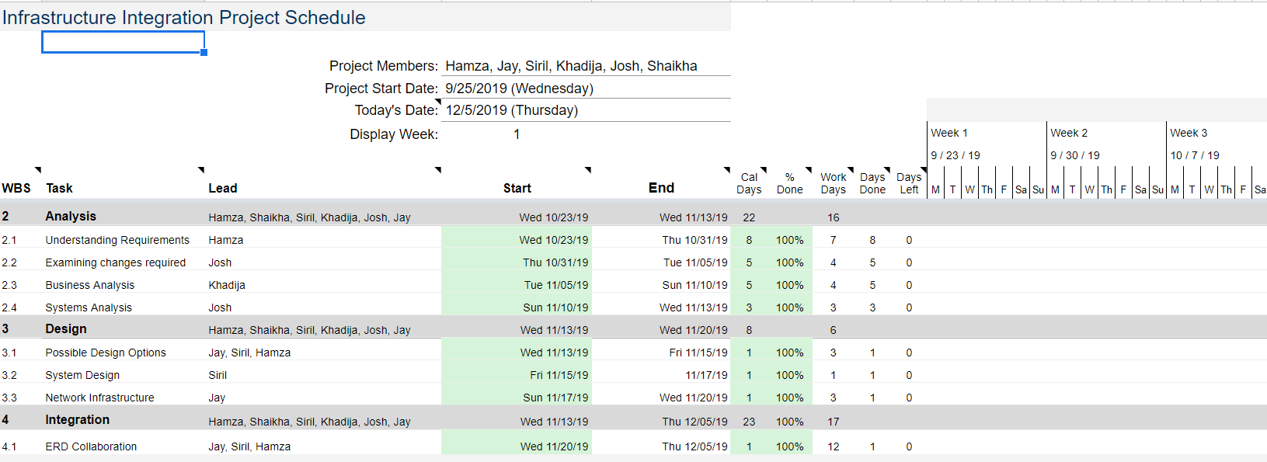
Project Plan

Slide 15
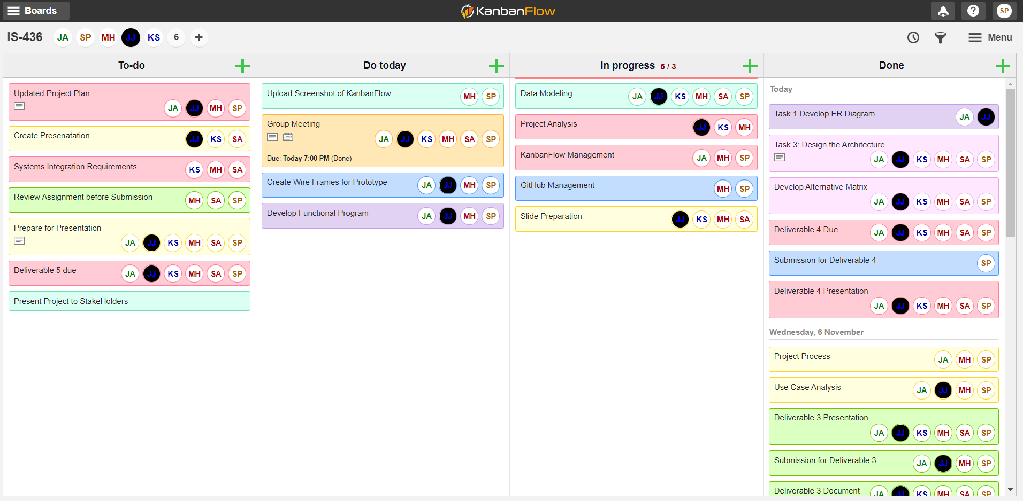
KanbanFlow

